Slide 1

2012 – 2014
Missouri Structures Project
Tim Haithcoat
Geographic Resources Center
Director, Principal Investigator
haithcoatt@missouri.edu
Mark Duewell
Geographic Resources Center
Project manager
Duewellm@missouri.edu
Chris Stephens
Geographic Resources Center
Geographic Information System Technician
Stephensca@missouri.edu
Lindlie Haithcoat
Geographic Resources Center
Geographic Information System Technician
haithcoatl@missouri.edu

Slide 2
Project Background
Three previous project iterations:
Two cooperatively funded by the FGDC/USGS Cooperative Agreement Program (CAP) funding and the Missouri Office of Homeland Security (New Madrid Seismic Zone)
      SEMO/Bootheel 2007-2008
      Boonslick RPC 2008-2009
Third funded by FGDC/USGS Partnership funding
      Mid-Missouri 2010-2011

Slide 3


Current Project …
Funded by Statewide ARRA Broadband Data & Development Program (SBDD) 2012 – 2014
Project ends August 2014
Provides residential and other point data to support two mapping / validation tasks.
Proper understanding of residential / business areas served or un-served (access & availability).
Collection, local review, and attribution of Community Anchor Institutions.

Slide 4
Goals
Data creation/maintenance – Categorized points for all man-made structures in Missouri, and footprints for larger buildings.
Data sharing partnerships – Designed to be easily maintained by each county so that it can stay current and relevant across Missouri’s landscape.
Enhanced regional working relationships - Promoting geospatial decision support for emergency events and disasters.
Prove the premise to state and federal entities that local government data is not only usually the most accurate but also the most timely, and the best datasets are those that are maintained locally.

Slide 5
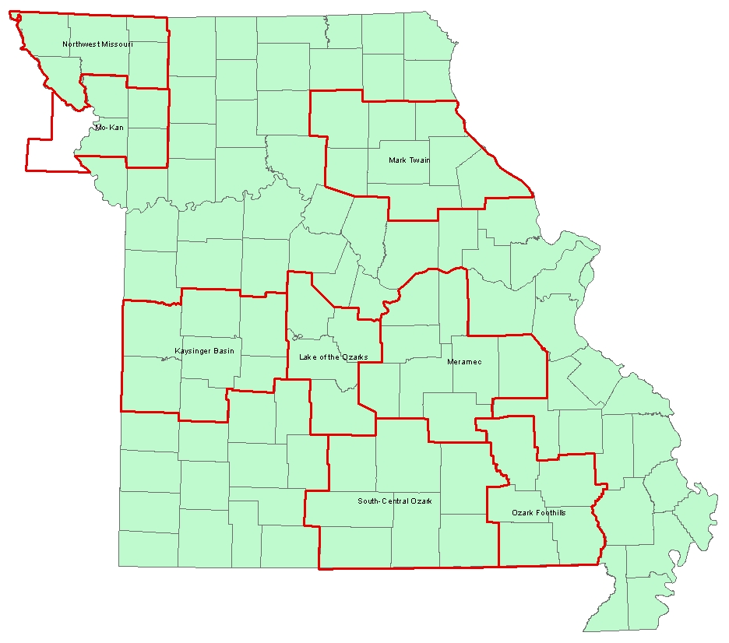
Structures – Year 1 – Proposed…

Slide 6
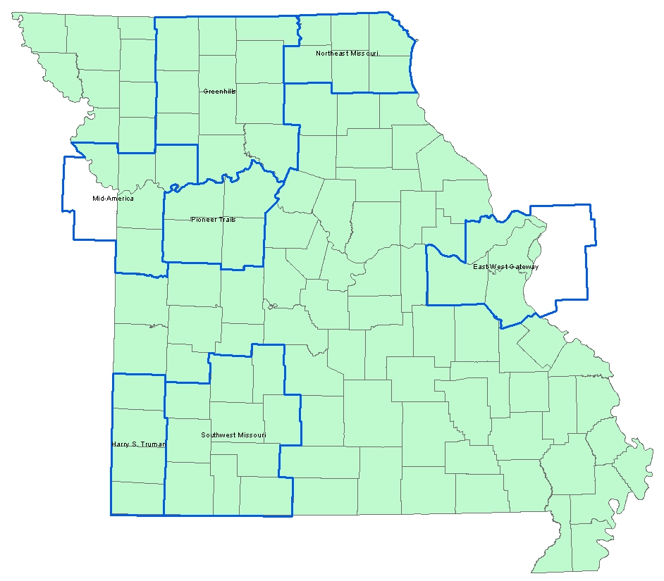
Structures – Year 2 – Proposed…

Slide 7
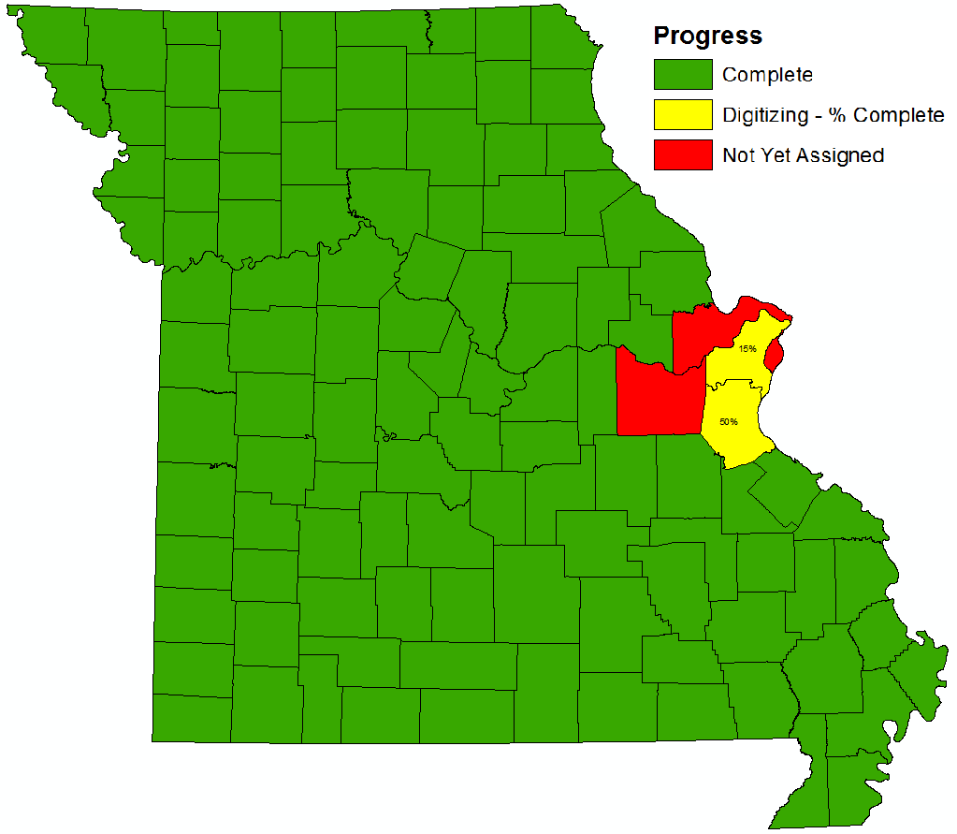
UMC Current Status

Slide 8
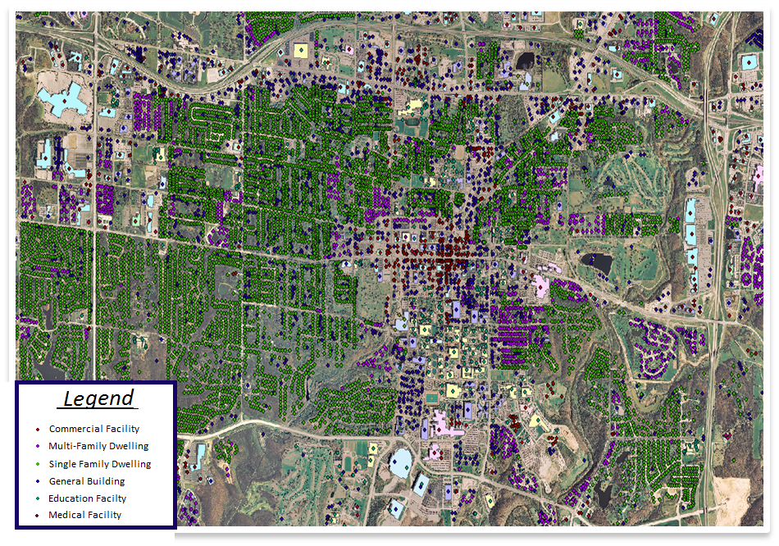

Slide 9
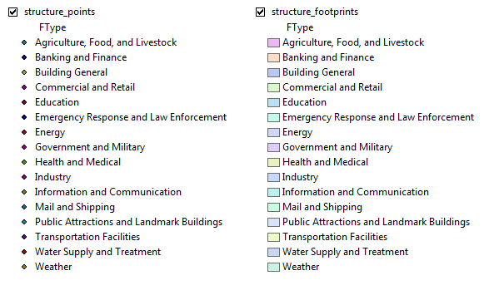
USGS Classification

Slide 10
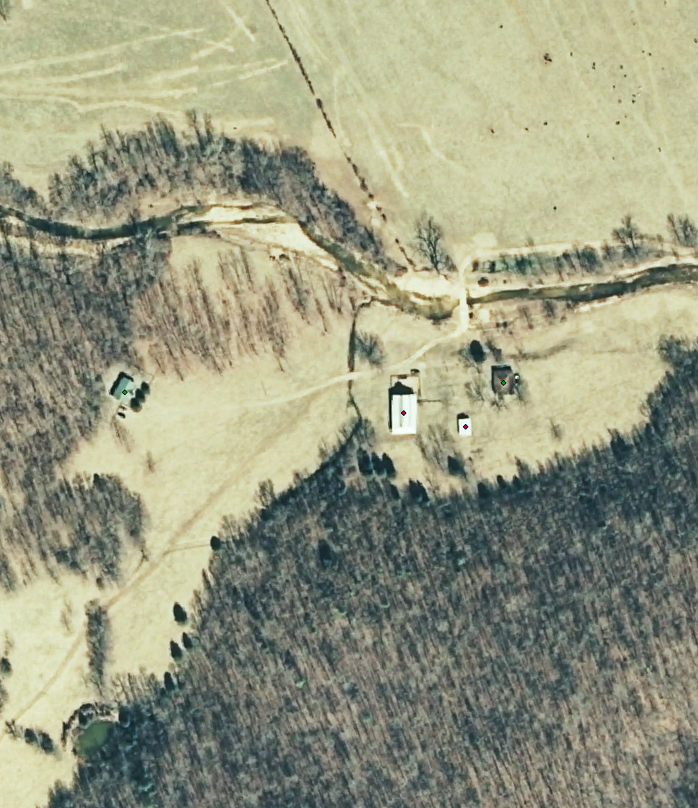
Structure Points
Labeled to the best of our ability.
(and Google’s)
Points should be placed in the center of the structures.
1 point per building.
(in most cases)

Slide 11
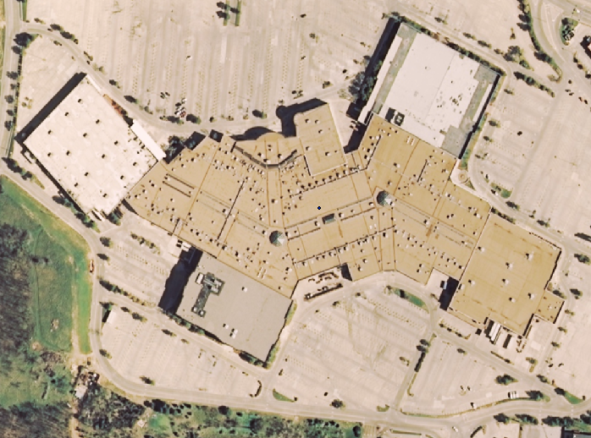
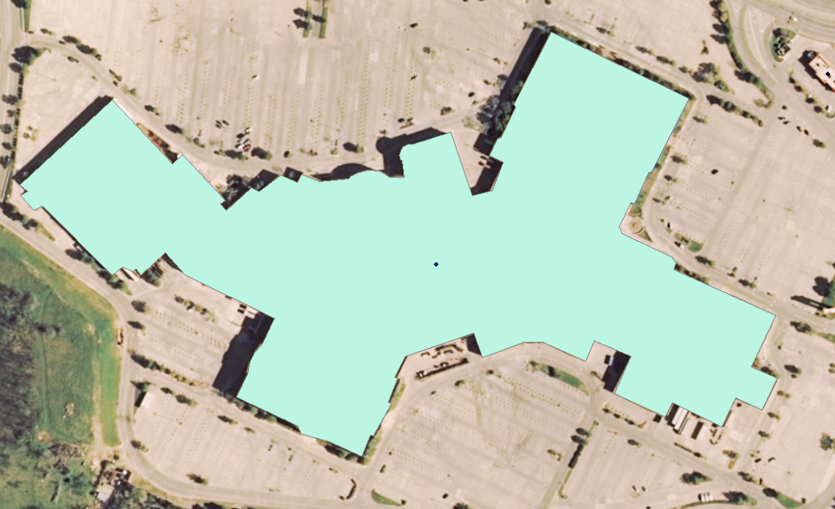
Structure Footprint
Columbia Mall
Structures bigger than 1 inch on screen @ 1:2000 scale.
“Rule of Thumb”
Follow outline of building as closely as possible, omitting shadow.
Footprinted buildings also get a point of the same category.

Slide 12
Value
Current iteration was created for:
  Broadband assessment of access and adoption – aid in validating maps.
  Broadband community planning and business case development.
  Monitoring of broadband adoption at Community Anchor Institutions.
Other planning uses as well as emergency uses include…

Slide 13
Other Values…
Emergency Response Value
Emergency events-Particularly events with large scale building destruction/damage.
  Powerful in the hands of local responders but will almost certainly be the best data available to state and federal first responders who are arriving on the scene.
  Response planning
  Decision support
  Evacuations
  Search & Recovery
  Damage assessment and remediation
Regional Value
Urban/Rural planning
    Zoning
    Ordinances
    Floodplain Management
    Transportation Planning
Economic Development
    State/Federal Grants
    Parks and Recreation
Public Safety
    Shelters
    Evaluating Access
    Emergency Preparedness
Service Delivery Analysis
    Education and Schools
    Utilities

Slide 14
Methodology
Regionalized local review – 2 Phases
  Community Anchor Points
  Structures
Elements
  Parallel roles – transportation plans, homeland security plans, economic development plans, etc. (multipurpose)
  Targeted layers and attributes derived from ARRA broadband requirements, local review, and homeland security input.
  Incentives – data, standards, tools.
  Tie-in with FirstNet development.
  Foundation of existing RTPT relationships and data development partnering from prior FGDC, CAP and USGS Partnership grants.

Slide 15
Standards
What was labeled?
  Man made buildings
  Boat docks with a roof
  Buildings under construction
  Silos, sheds, farm buildings, small outbuildings
  School busses, RV’s, and trailers on personal property
What wasn’t labeled?
  Water towers
  Bridges
  Docks without a roof
  Communication towers
  School busses, RV’s, and trailers in parking lots

Slide 16
Methods
Schema
  Developed during the New Madrid Seismic Zone Structures Project
  USGS Classification System
  1 Point per building (centered)
  Building Footprints - Outline traced around building for polygons
Scale
  Extraction of points at a 1:2000
  Extraction of polygons when buildings are 1 inch on screen at a 1:2000
  All corrections are done at a 1:2000
U.S. National Grid coordinates, Lat. + Long.
Imagery
  First Pass = State 2ft Imagery from MSDIS
    2007-2008 data
  Review = ESRI Basemap & NAIP2012
    More current/sharper images
    More detailed data added

Slide 17
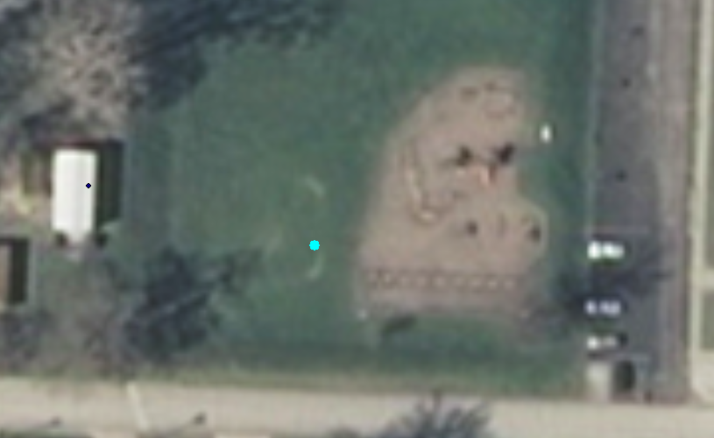
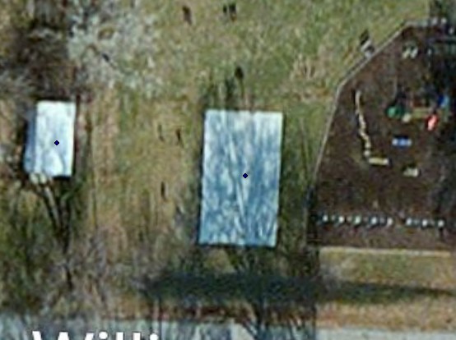
Review Process
Checked completed county using NAIP 2012 imagery.
If structure is not in 2008 imagery but is in 2012 imagery, add date to PT_DATE field. If structure is not in 2012 but is in 2008, put 2008 in PT_DATE field. If the building appears in both sets of imagery there will be no date in the PT_DATE field.
2008 Imagery
NAIP 2012

Slide 18
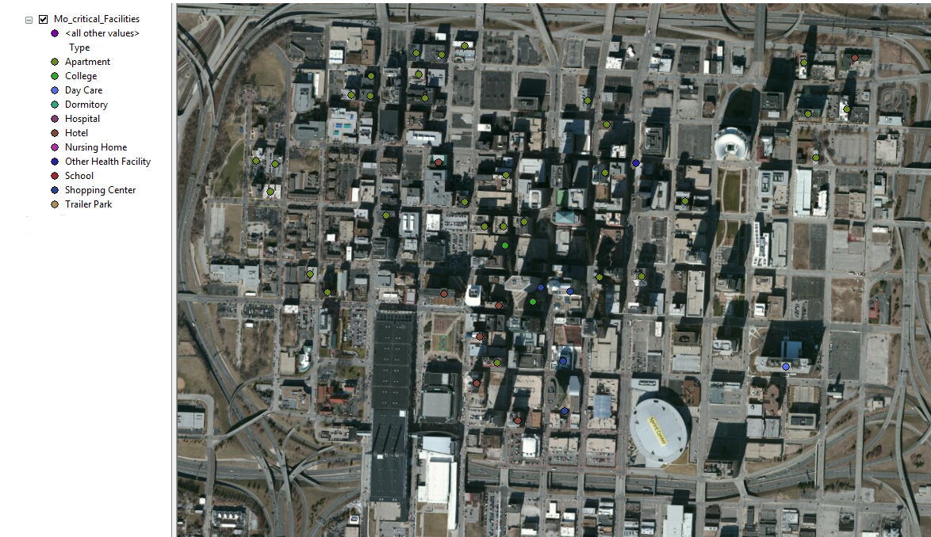
Your Local Data
  Integrated into dataset
  Attributed with USGS classification
  Nothing edited or deleted
Data Provided by MARC

Slide 19
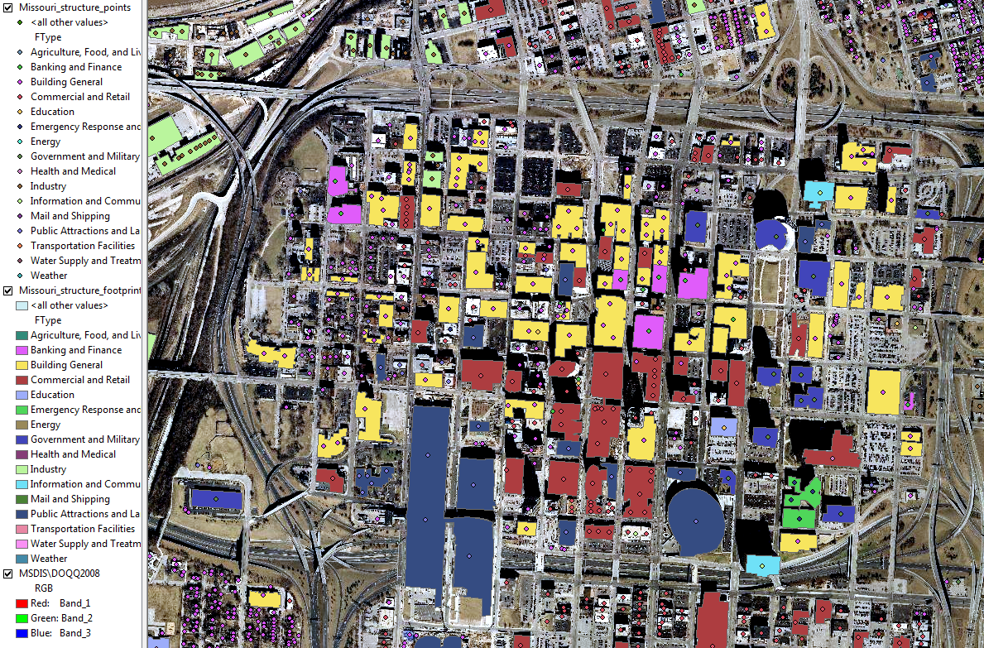
Current dataset integrated with MARC data

Slide 20
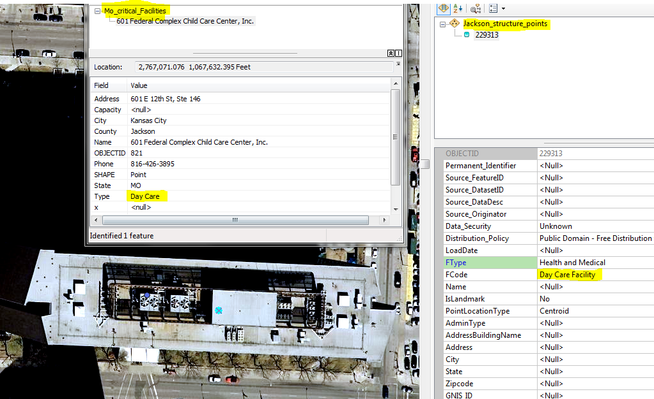
Buildings labeled according to your local data:
Our point
Your point

Slide 21
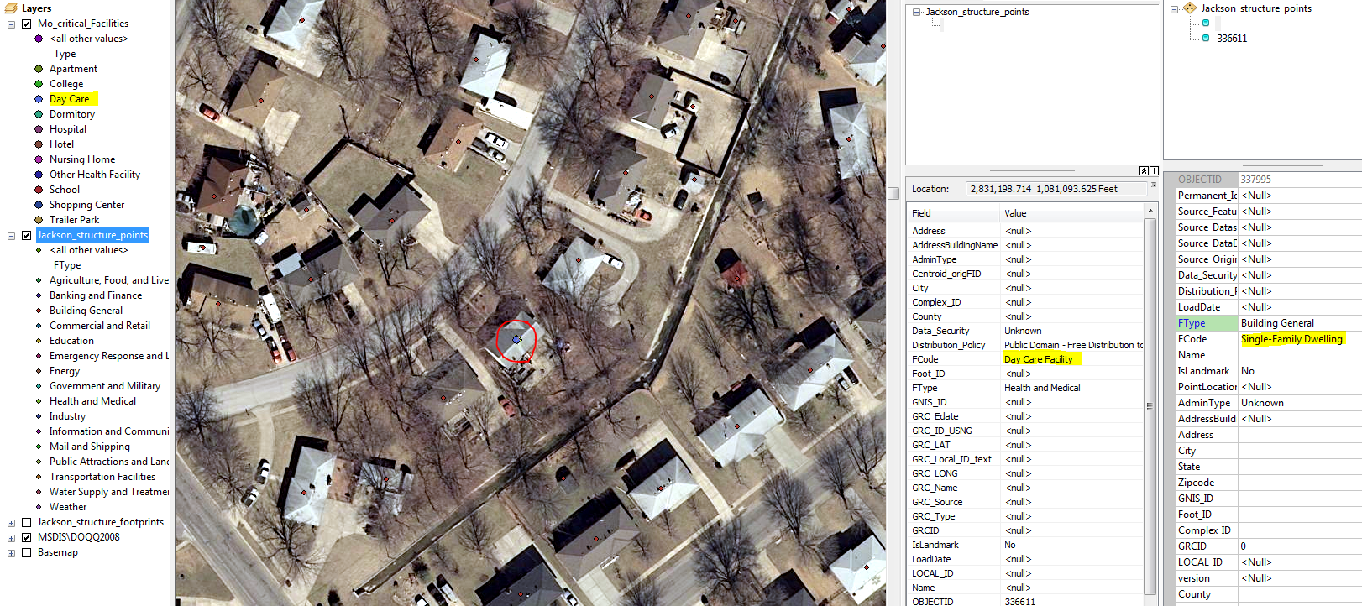
Some structures have more than one point:
Some homes were also labeled as a Day Care by your data so they are both
Single-Family Dwelling and a Day Care Facility in the new dataset.

Slide 22
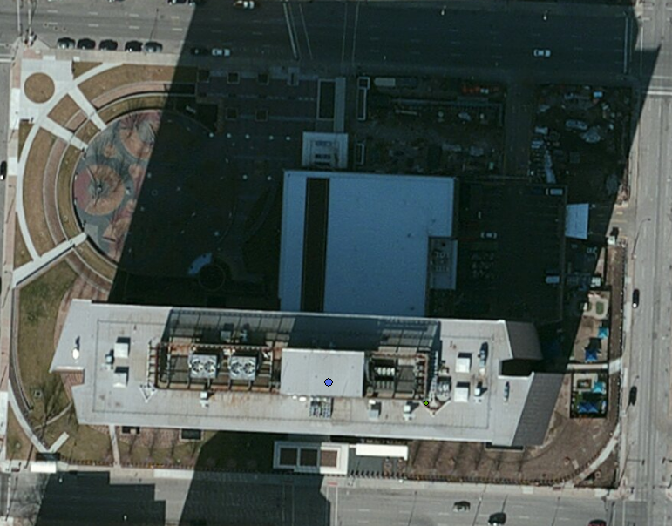
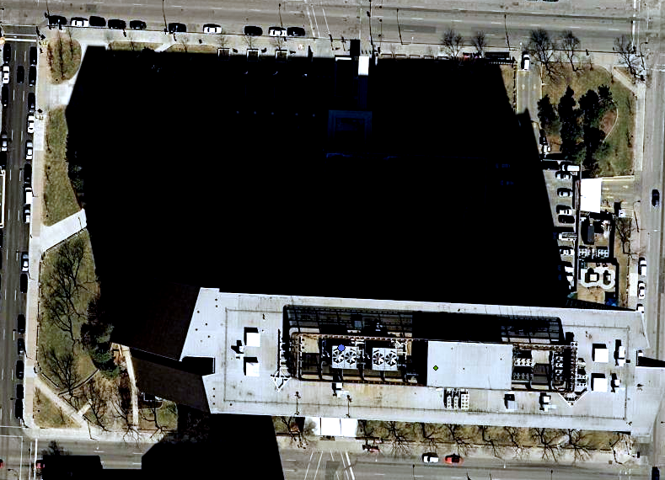
Imagery Differences
-taken at different angles, points off center
-our data lines up with our 2008 imagery
ESRI Basemap
MSDIS 2008

Slide 23
Deliverables
Mail us the thumb drive with the data
Structures data due 6 months from this training date
Improve dataset using local knowledge
  Make the data useful to you

Slide 24
Any Questions?
Chris Stephens
Geographic Resources Center
Geographic Information System Technician
Stephensca@missouri.edu
Lindlie Haithcoat
Geographic Resources Center
Geographic Information System Technician haithcoatl@missouri.edu

